Slide 1
Welcome to
Trustee Budget
Training
Sylvie Godbout
Kimberly Meanix Miller
Wednesday, August 21, 2019
Trustee Student Organization Financial Programs, Services and Initiatives

Slide 2
Agenda
Stakeholders
Purpose
Methodology
Process
Chart of Accounts
Timeline
Questions

Slide 3
Stakeholders
University {Provost, Executive Vice President for Administration & Chief Financial Officer}
Who assembles & empowers
Makes recommendation on fees for Board of Trustees
Student Fee Advisory Committee
{Staff and students chaired by David Clokey}
Student Fee Advisory Committee = {Staff and students chaired by David Clokey}
Financial Advisor
{Our Office}
Requests information, sets deadlines and holds hearings
Support
Submits documents & presents during hearing
Organization:
Engages their constituents & members for input & formally approves multi-year budget plan

Slide 4
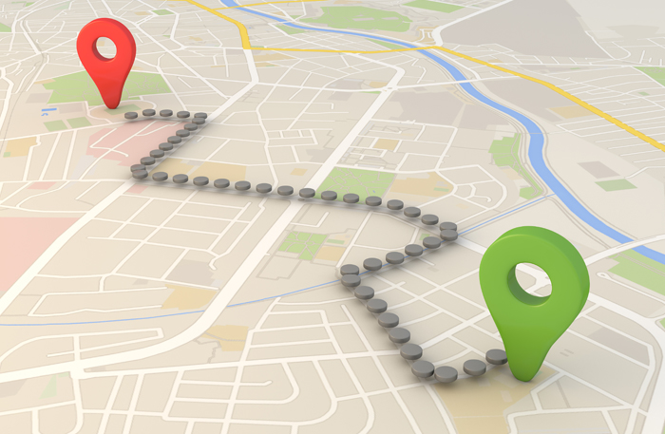
Purpose
Meet Request of Stakeholders
Demonstrate Financial Stewardship
Demonstrate Transparency
Plan for the Future → Road Map
Timely Awareness to Allow for Adjustment

Slide 5
Fall Timeline
By 30th:
Current FY Operating Budget voted on and submitted to TSOS*
Budget Forums completed where input is sought; ideally constituents first and then members
September
By 15th: Based on input, factors influencing budget and vision, President & Treasurer construct budget and submit entire packet to TSOS for review and comment
By 31st: TSOS will return comment to Organizations in order the budget documents were submitted
October
By 15th: Considering TSOS input, President & Treasurer present budget packet to Organization for approval by formal vote
By 22nd^{th}: Formally approved budget packet submitted to SFAC. If seeking fee increase, next steps will be communicated
November
* FY21 – will change to end of Spring Semester

Slide 6
Winter Timeline
No budget activity unless seeking fee increase
December
Invited to come together to practice SFAC presentations and provide feedback to peers
January
MLK Day
Early Feb: Open Forum held by SFAC for general student body input and/or questions
Mid Feb: Hearings held by SFAC for Trustee Organizations; President and Treasurer make a formal presentation and answer any questions
February

Slide 7
Methodology
Determine and justify any required fund balance
Identify any starting fund balance
Anticipate student fee revenue
Maximize expenditures to benefit students that pay the fee
Allow flexibility to adjust expenditures up or down as actual revenues solidify

Slide 8
Process
Student Activity and Service Fee Advisory Committee Fact Sheet
Storrs Student Activity Fund Budget Narrative Questions
Numbers

Slide 9
Chart of Accounts
Know the Accounts
Be Consistent
Know how your Org Utilizes the COA
Income
Expenses
Tips
Surplus
Misc
Gifts
Refreshments
Student Wages

Slide 10
Budget Starting Point
DSA Trustee Student Organization Financial Programs, Services and Initiatives provides:
Enrollment Numbers to determine Student Fees*
Permanent Employee Costs, if applicable
Greyed Actuals from previous fiscal year
Greyed column presented previous spring by Org as “FY20 Updated” becomes “FY20 Original”
Greyed column presented previous spring by Org as “FY21 Projected” becomes “FY21 Original”
Starting Balance

Slide 11
Organization Budget Work
Already completed an Operating Budget for FY19 which becomes “FY20 Updated”
Must determine projections for:
FY 21 “Updated”
FY 22 “Projected”
Where to start?
Past
Actuals much different than previous projection in any category
Input from past officers on changes
Future
Changes you are aware of over which you have no control (enrollment, vendor costs, minimum wage)
Change in Direction of Organization
Anticipate Questions & Address
Timeline

Slide 12
Questions
Sylvie Godbout Sylvie.Godbout@UConn.edu
Kimberly Meanix Miller Kimberly.Miller@UConn.edu
Office 860-486-6461
Trusteeorgsupport.uconn.edu
{under construction}
Thank you!

